Slide 1

Unit-1
Abhishek S. Rao

Slide 2
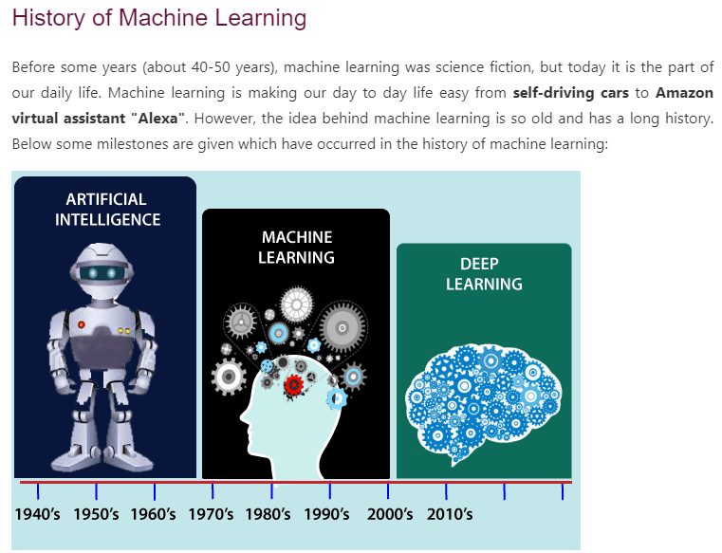

Slide 3
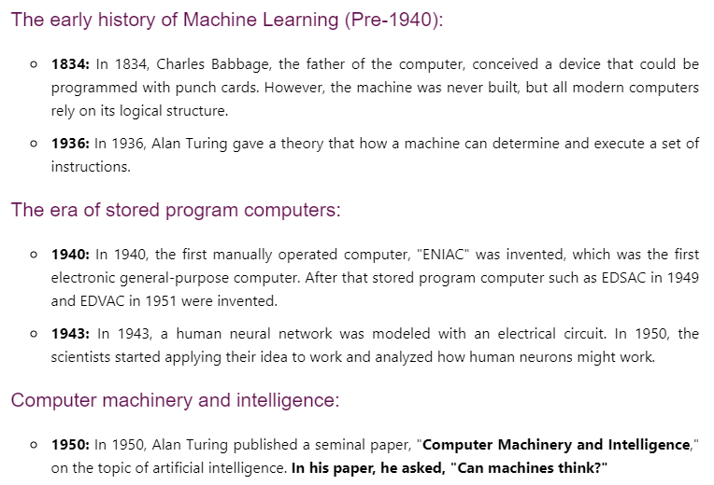

Slide 4
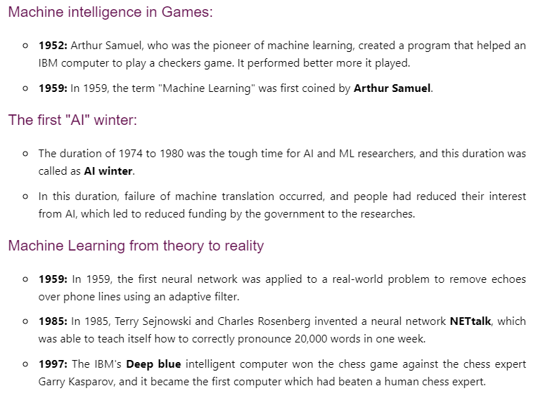
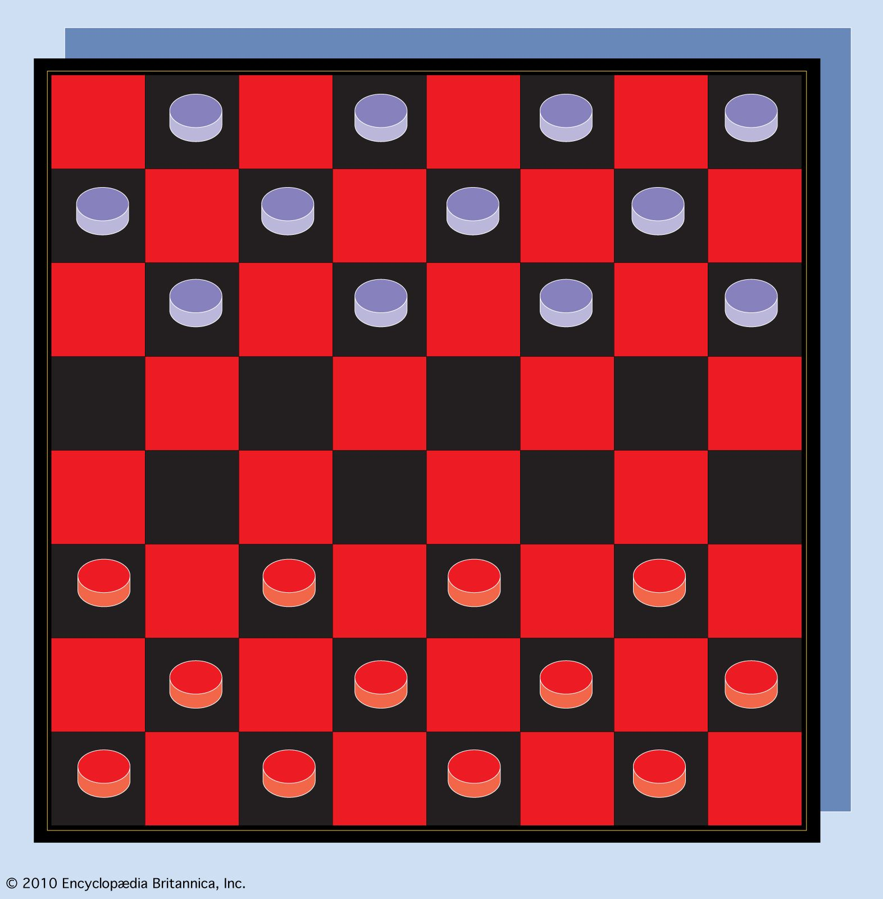

Slide 5
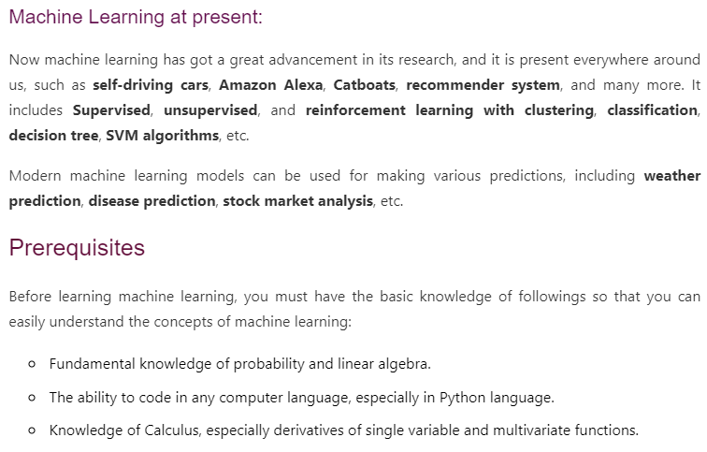

Slide 6
Introduction
Ever since computers were invented, we have wondered whether they might be made to learn.
If we could understand how to program them to learn-to improve automatically with experience-the impact would be dramatic.
Imagine computers learning from medical records which treatments are most effective for new diseases, houses learning from experience to optimize energy costs based on the usage patterns of their occupants, or personal software assistants learning the evolving interests of their users in order to highlight especially relevant stories from the online morning newspaper.
A successful understanding of how to make computers learn would open many new uses of computers and new levels of competence and customization.
And a detailed understanding of information processing algorithms for machine learning might lead to a better understanding of human learning abilities (and disabilities) as well.

Slide 7
We do not yet know how to make computers learn nearly as well as people learn. However, algorithms have been invented that are effective for certain types of learning tasks, and a theoretical understanding of learning is beginning to emerge.
Many practical computer programs have been developed to exhibit useful types of learning, and significant commercial applications have begun to appear.
For problems such as speech recognition, algorithms based on machine learning outperform all other approaches that have been attempted to date.
In the field known as data mining, machine learning algorithms are being used routinely to discover valuable knowledge from large commercial databases containing equipment maintenance records, loan applications, financial transactions, medical records, and the like.

Slide 8
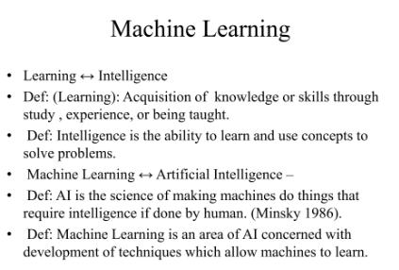

Slide 9
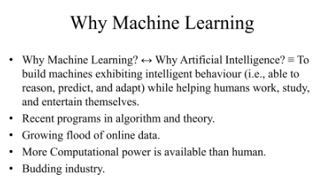

Slide 10
WELL-POSED LEARNING PROBLEMS
Definition: A computer program is said to learn from experience E with respect to some class of tasks T and performance measure P, if its performance at tasks in T, as measured by P, improves with experience E.

Slide 11
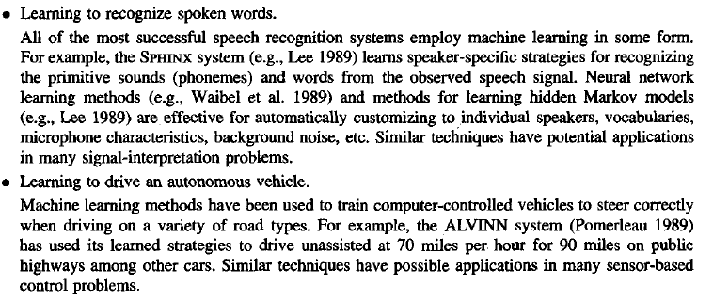
In general, to have a well-defined learning problem, we must identity these

Slide 12
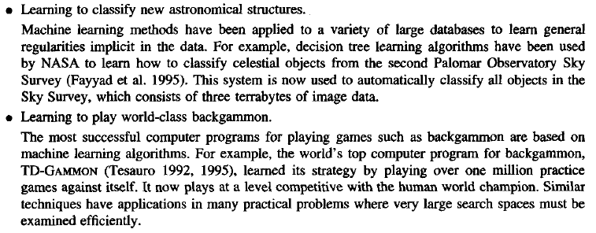

Slide 13
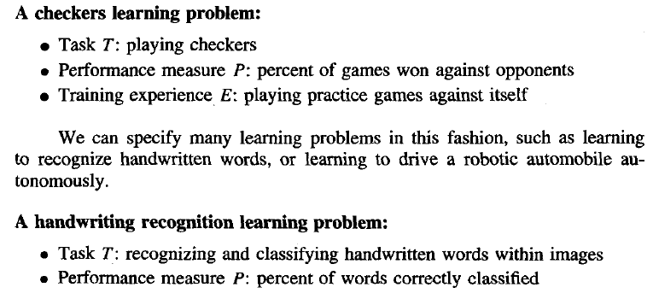

Slide 14
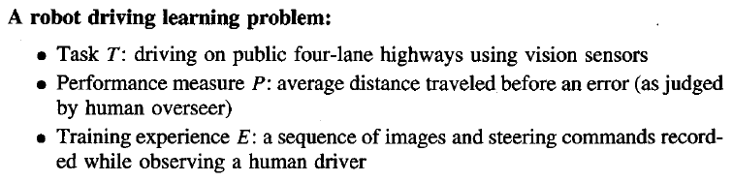

Slide 15
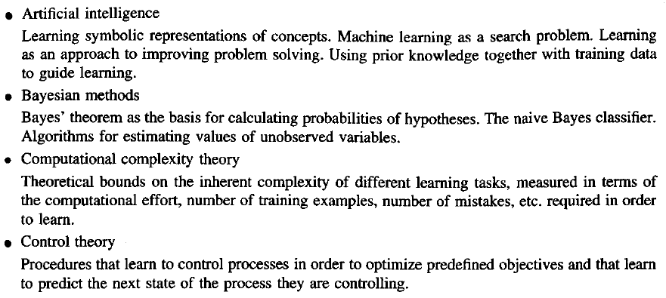
Some disciplines and examples of their influence on machine learning.

Slide 16
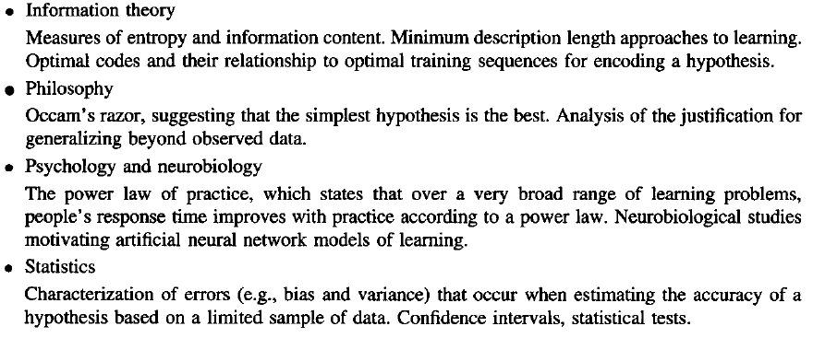

Slide 17
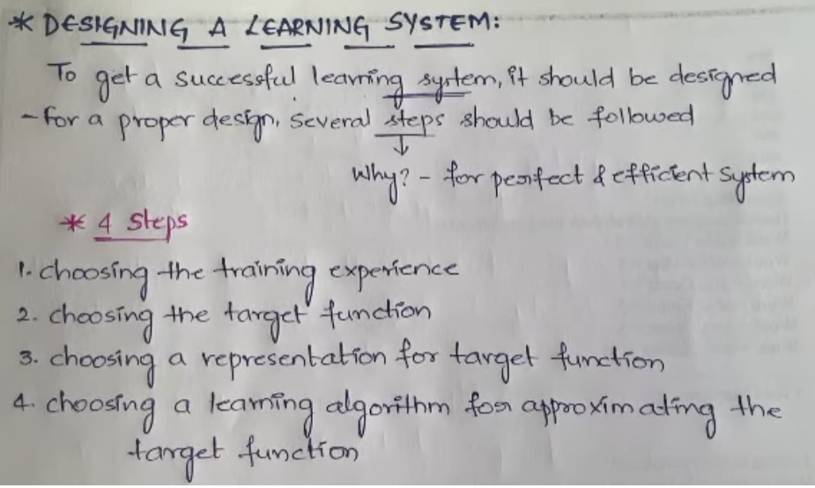

Slide 18
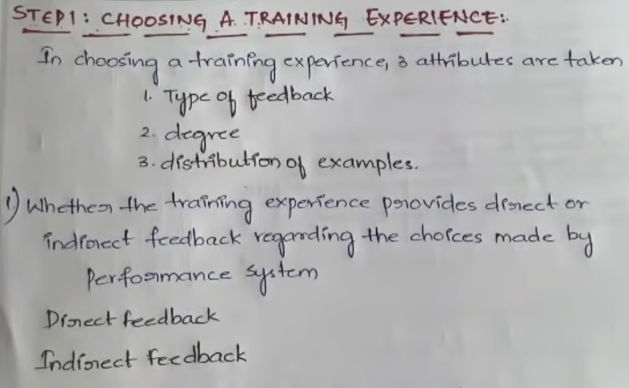
Ex: Checkers Game (Direct Feedback), Learning Driving (Indirect feedback (AI-based Trainer))

Slide 19
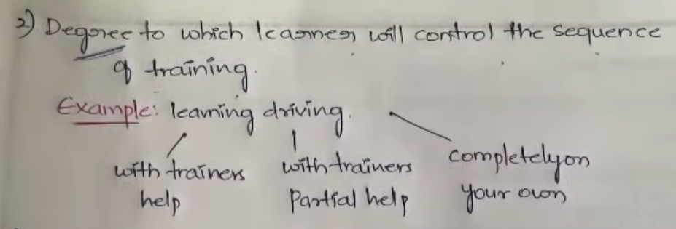
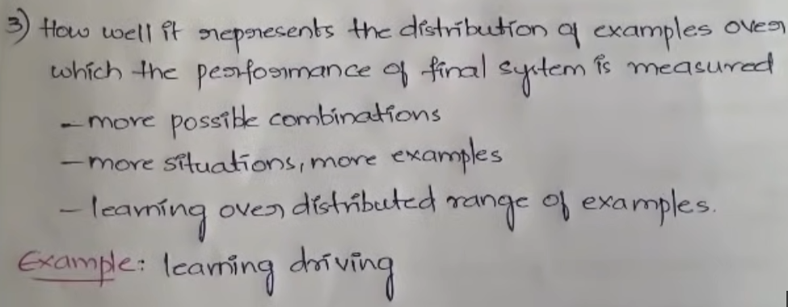

Slide 20
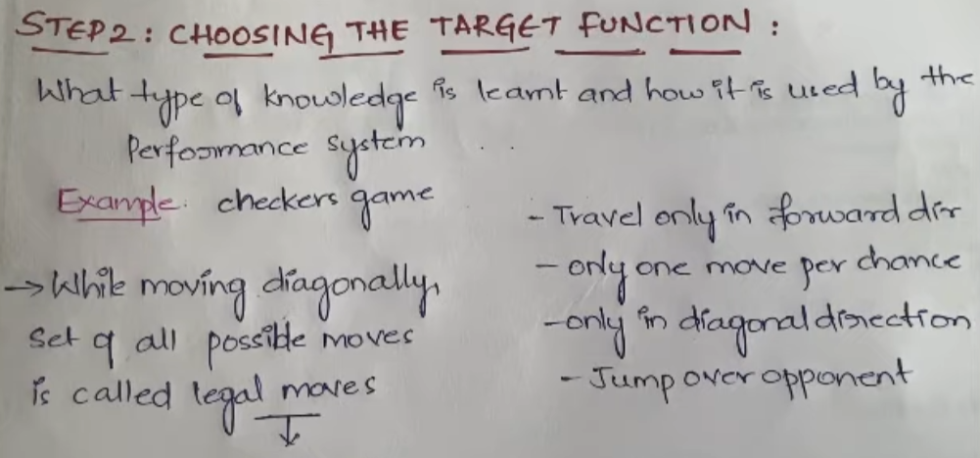
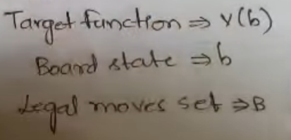
The target function will include what type of knowledge is learned by the machine and whether that knowledge is useful.

Slide 21
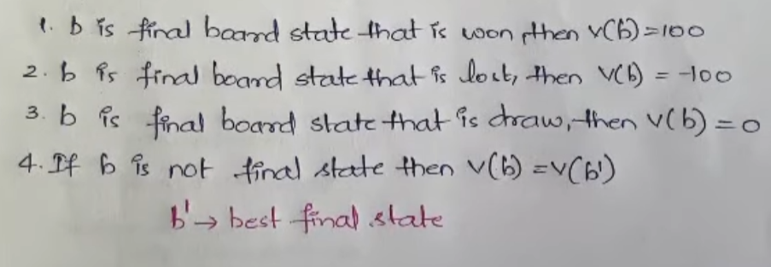

Slide 22


Slide 23
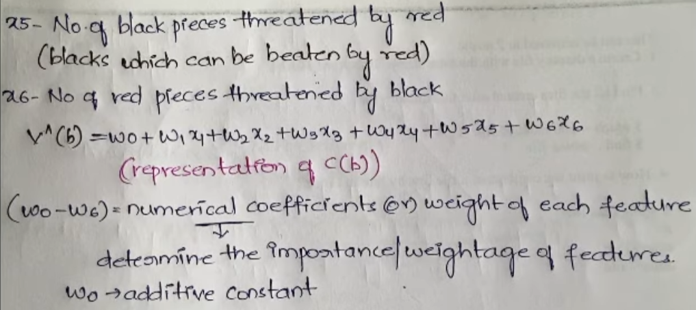

Slide 24
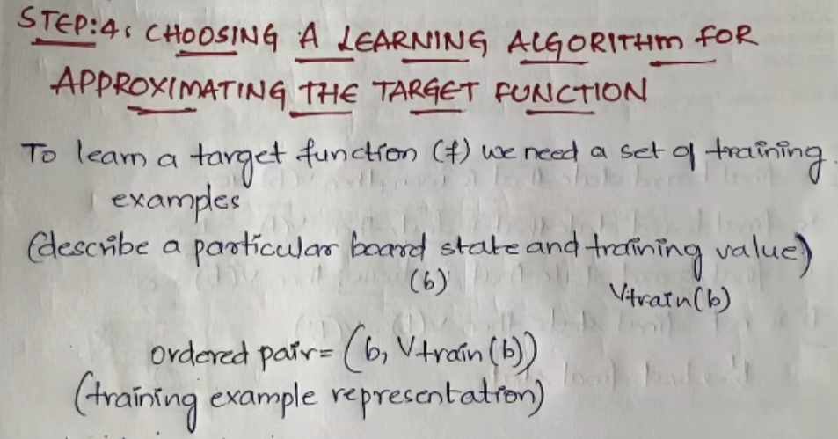

Slide 25
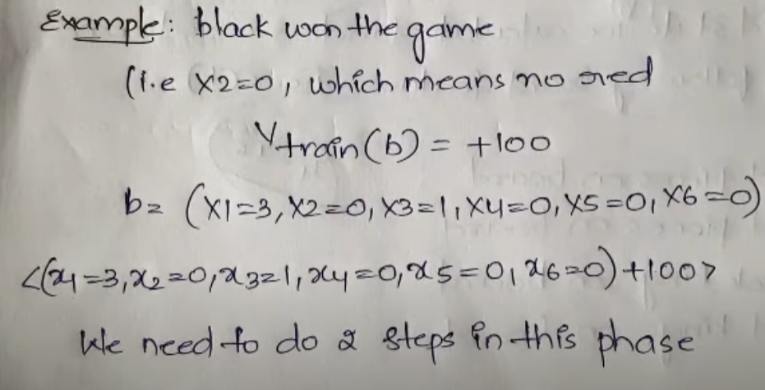

Slide 26
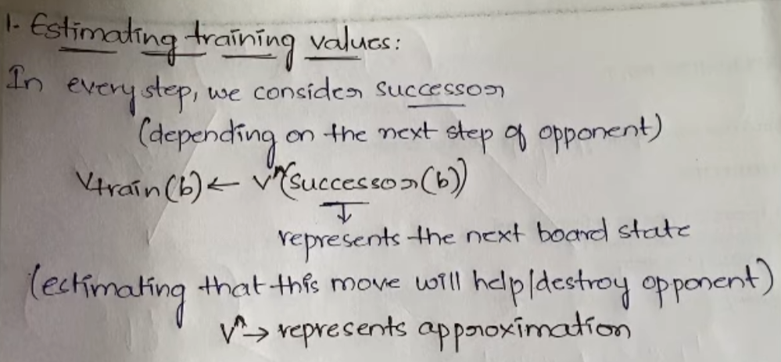

Slide 27
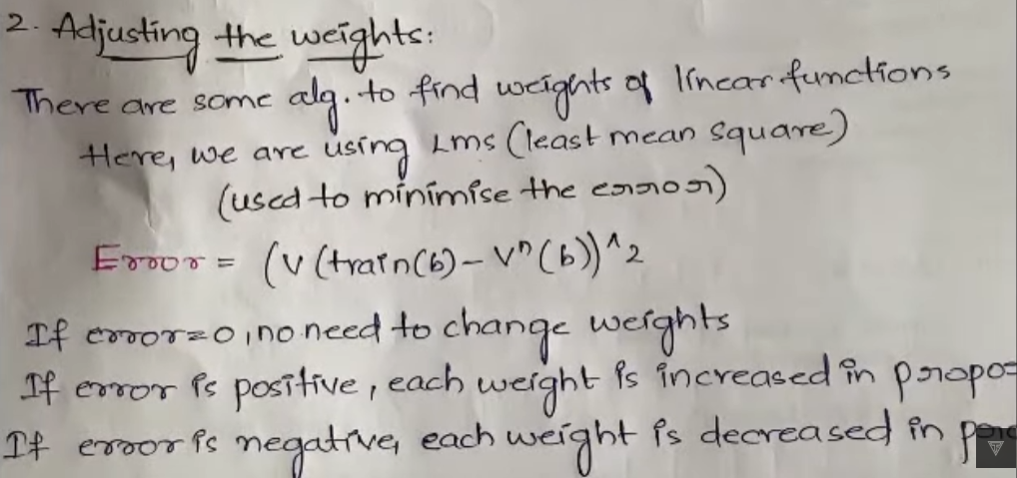

Slide 28
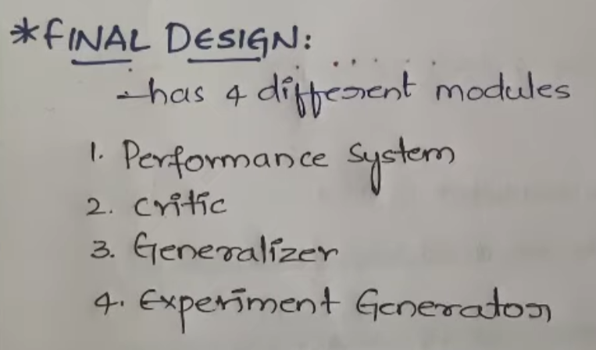

Slide 29
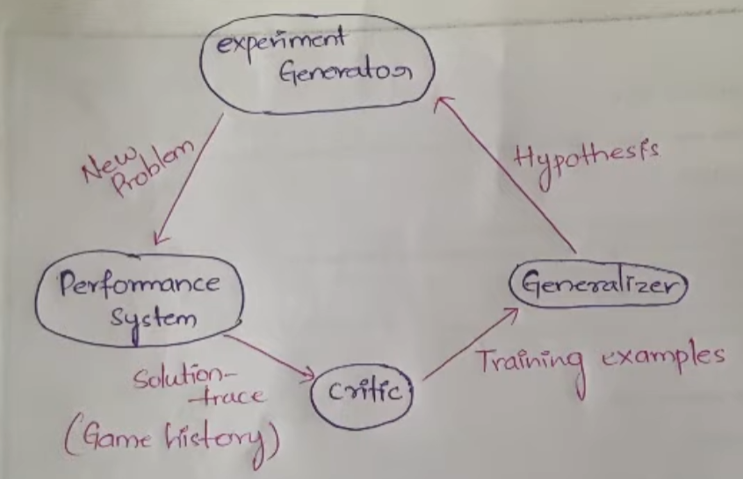

Slide 30
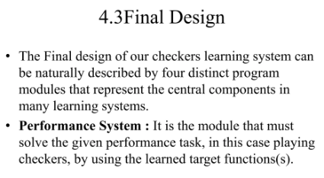

Slide 31
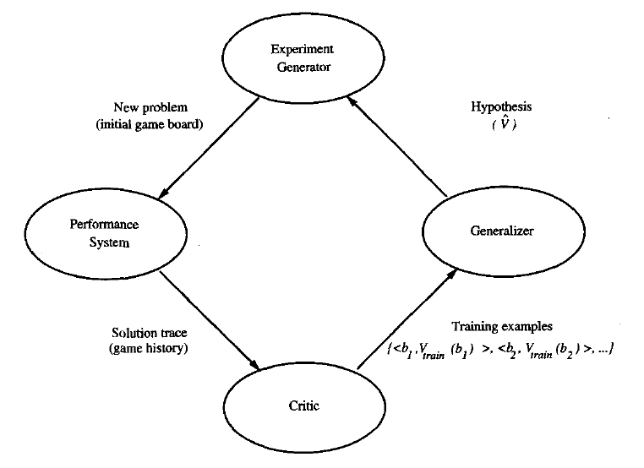

Slide 32
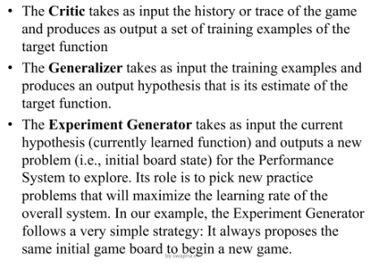

Slide 33
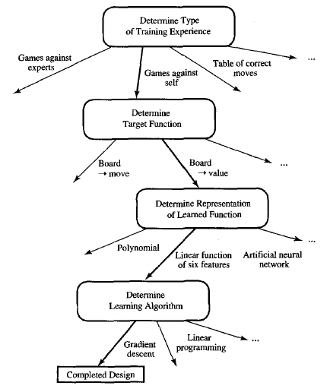

Slide 34
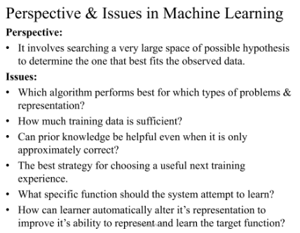

Slide 35
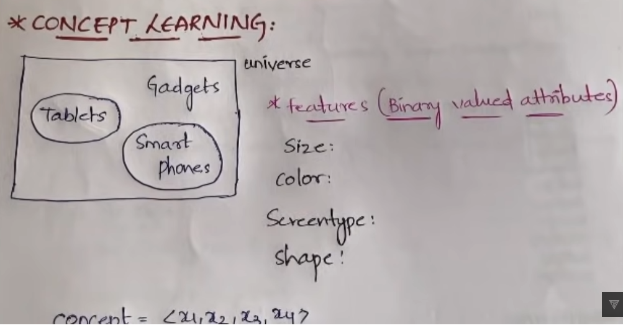
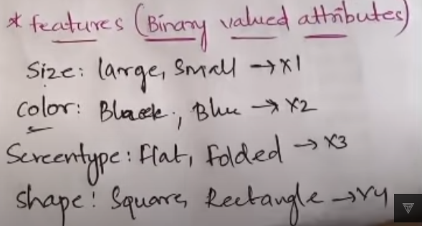

Slide 36
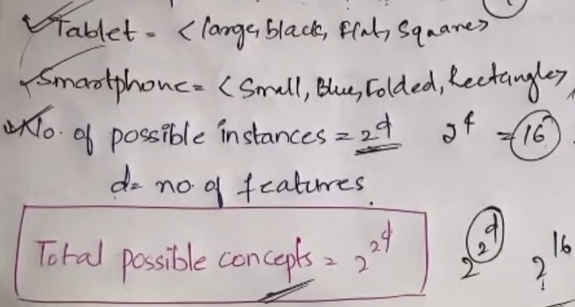

Slide 37
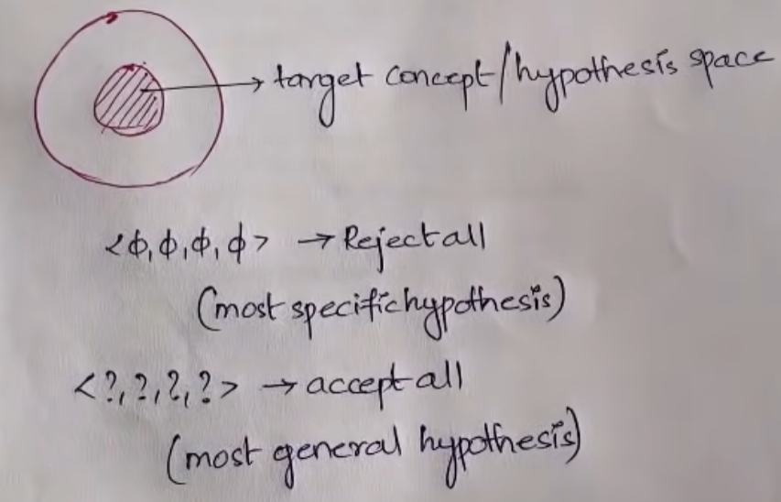

Slide 38
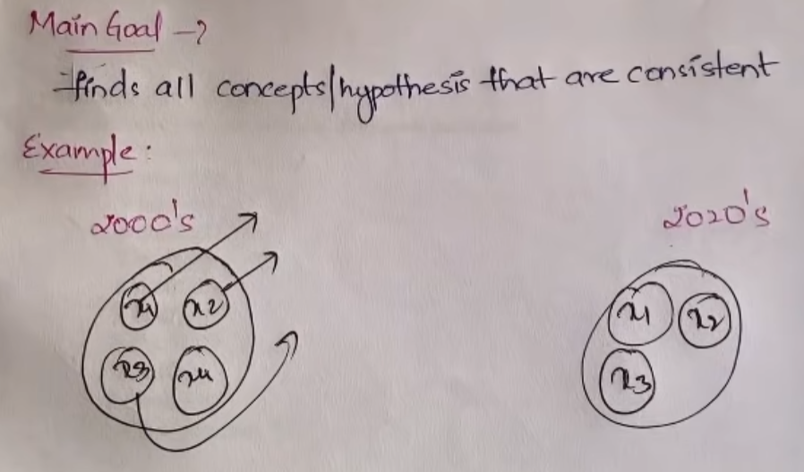

Slide 39
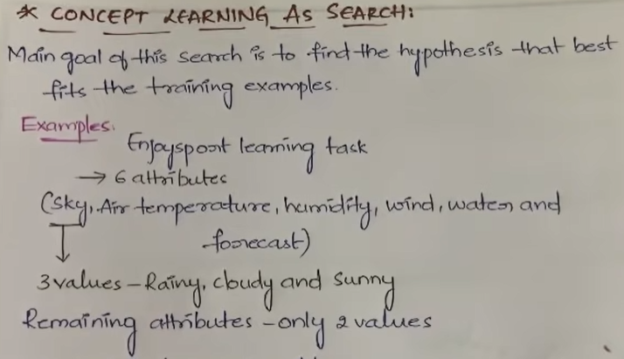

Slide 40
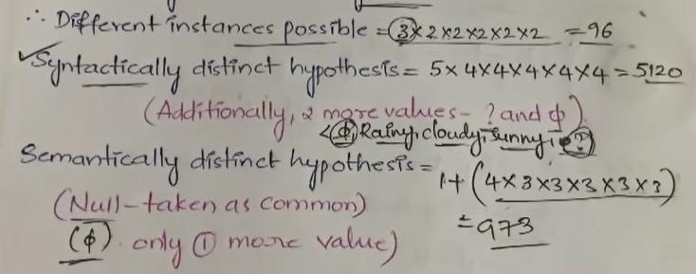
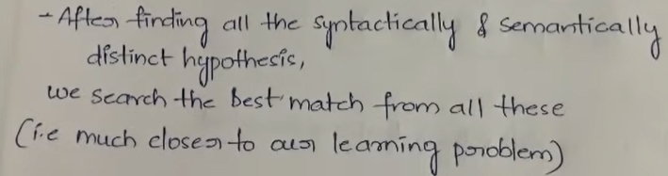

Slide 41
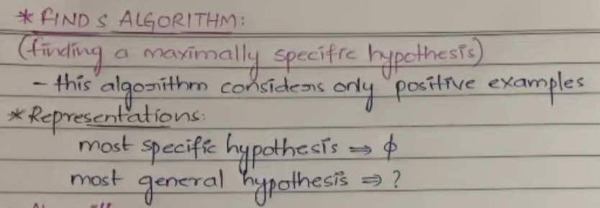

Slide 42
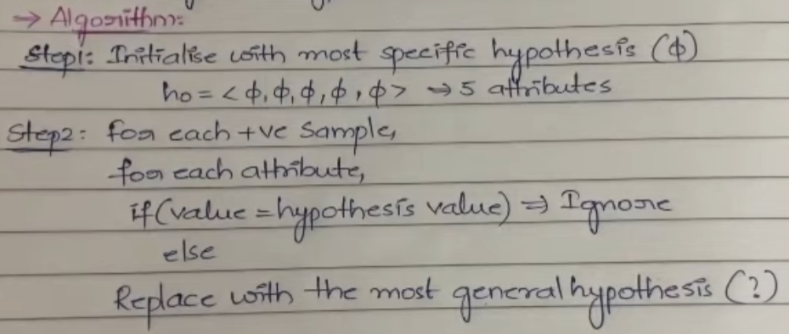

Slide 43
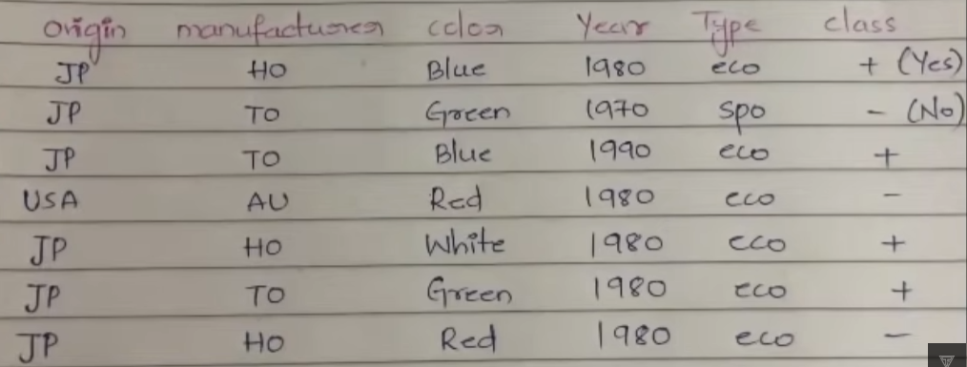

Slide 44
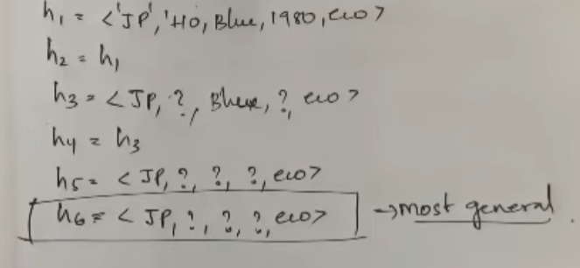

Slide 45
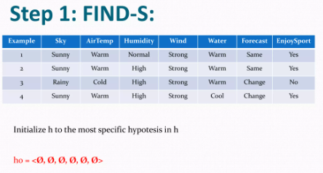

Slide 46
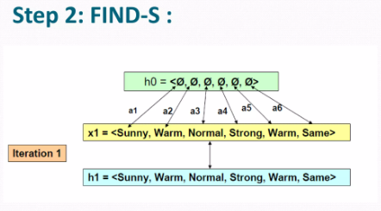

Slide 47
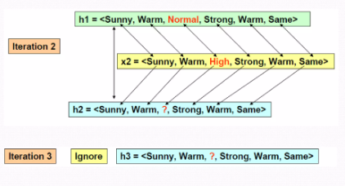

Slide 48
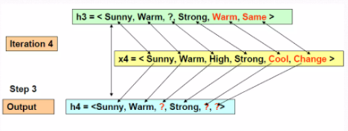

Slide 49
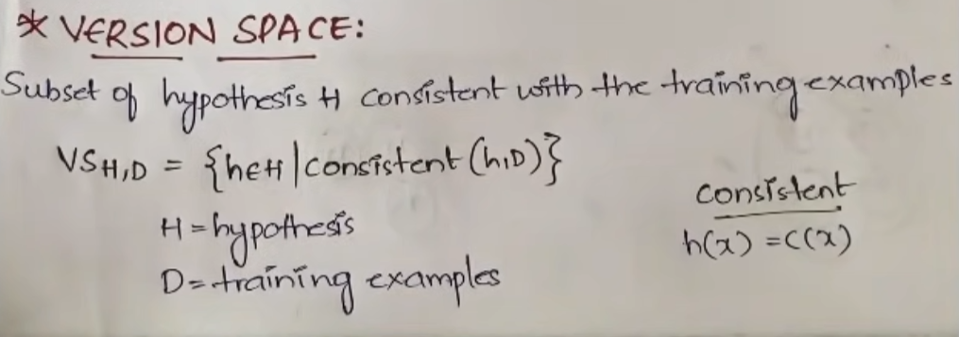

Slide 50
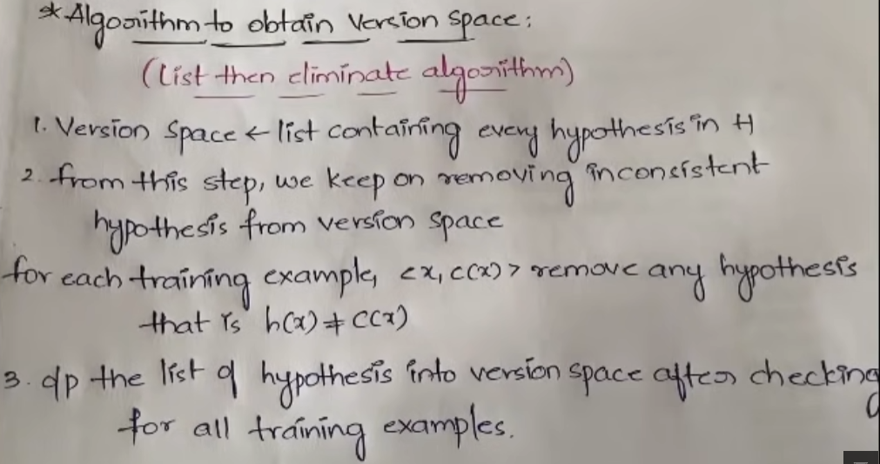

Slide 51


Slide 52


Slide 53


Slide 54


Slide 55


Slide 56


Slide 57


Slide 58


Slide 59


Slide 60



Slide 61



Slide 62


Slide 63


Slide 64


Slide 65


Slide 66


Slide 67
Decision Tree Learning
Decision tree learning is one of the most widely used and practical methods for inductive inference. It is a method for approximating discrete-valued functions that is robust to noisy data and capable of learning disjunctive expressions. This chapter describes a family of decision tree learning algorithms that includes widely used algorithms such as ID3, ASSISTANT, and C4.5. These decision tree learning methods search a completely expressive hypothesis space and thus avoid the difficulties of restricted hypothesis spaces. Their inductive bias is a preference for small trees over large trees.

Slide 68
Decision tree learning is a method for approximating discrete-valued target functions, in which the learned function is represented by a decision tree. Learned trees can also be re-represented as sets of if-then rules to improve human readability.
These learning methods are among the most popular of inductive inference algorithms and have been successfully applied to a broad range of tasks from learning to diagnose medical cases to learning to assess credit risk of loan applicants.

Slide 69


Slide 70
Decision trees classify instances by sorting them down the tree from the root to some leaf node, which provides the classification of the instance.
Each node in the tree specifies a test of some attribute of the instance, and each branch descending from that node corresponds to one of the possible values for this attribute.
An instance is classified by starting at the root node of the tree, testing the attribute specified by this node, then moving down the tree branch corresponding to the value of the attribute in the given example. This process is then repeated for the subtree rooted at the new node.

Slide 71

THE BASIC DECISION TREE LEARNING ALGORITHM

Slide 72

ID3 Algorithm

Slide 73


Slide 74




Slide 75


Slide 76



Slide 77




Slide 78


Slide 79


Slide 80


Slide 81


Slide 82


Slide 83




Slide 84


Slide 85


Slide 86


Slide 87


Tree Pruning

Slide 88


Slide 89


Slide 90


Slide 91
Similarities: Nearest-Neighbor Classifiers
Two plants that look very much alike probably represent the same species; likewise, it is quite common that patients complaining of similar symptoms suffer from the same disease.
In short, similar objects often belong to the same class—an observation that forms the basis of a popular approach to classification: when asked to determine the class of object x, find the training example most like it. Then label x with this example’s class.

Slide 92

The k-Nearest-Neighbor Rule
Dealing with continuous attributes is just as simple. The fact that each example can be represented by a point in an n-dimensional space makes it possible to calculate the geometric distance between any pair of examples, for instance, by the Euclidean distance. And again, the closer to each other the examples are in the instance space, the greater their mutual similarity. This, by the way, is how the nearest-neighbor classifier got its name: the training example with the smallest distance from x in the instance space is, geometrically speaking, x’s nearest neighbor.

Slide 93


Slide 94


Slide 95
Any distance metric must satisfy the following
requirements:
1. the distance must never be negative;
2. the distance between two identical vectors, x and y, is zero;
3. the distance from x to y is the same as the distance from y to x;
4. the metric must satisfy the triangular inequality: d(x, y)+ d(y, z)>= d(x, z).

Slide 96



Slide 97


Slide 98


Slide 99


Slide 100

Irrelevant Attributes and Scaling Problems

Slide 101


Slide 102


Slide 103


Slide 104


Slide 105


